Slide 1


Unlocking Sales Potential: Harnessing Data Analytics with Power BI
Project Guide: Rajanarayanan
Presented By: Rakshitha S

Slide 2
Abstract
1. AtliQ Hardware encounters difficulties in tracking sales and extracting actionable insights due to data management and communication issues.
2. Implement a Power BI dashboard to provide the sales manager with clear, data-driven insights into sales performance.
3. The project targets the needs of the sales manager, regional managers, and other personnel involved in sales analysis and decision-making.
4. The dashboard aims to improve understanding of sales performance, identify areas for improvement, and empower data-driven decision-making.
5. The project follows a structured approach, encompassing problem definition, data discovery/cleaning/merging, and Power BI dashboard creation.
6. The project seeks to deliver a user-friendly, visually intuitive dashboard that empowers stakeholders with key sales metrics and trends.

Slide 3
INTRODUCTION
1.AtliQ Hardware is using data analytics (Power BI) to improve sales performance by analyzing their sales data (from MySQL) for trends and optimization opportunities.
2. This includes cleaning and visualizing data on markets, products, and customers, focusing on revenue trends from January 2018 to June 2020.
3. By ensuring ETL processes for data accuracy, market categorization, and currency considerations.
4.The goal is to provide actionable insights for informed decision-making and better sales outcomes, highlighting the importance of data-driven strategies in business success

Slide 4
SI NO | Title of the Study/Reference | Authors/Journal | Key Concepts/Theories Used | Strengths and Limitations
1 | Analyzing Data with Power BI and Power Pivot for Excel" by Alberto Ferrari and Marco Russo. | Alberto Ferrari and Marco Russo | Methodology: Employ SQL for data extraction and preparation, then leverage DAX in Power BI for advanced analysis and visualization. Framework: Utilize a structured approach involving data collection, modeling, analysis, iterative refinement, documentation, and deployment for effective data-driven insights. | Strengths: SQL enables efficient querying and DAX in Power BI offers advanced analytics, providing powerful data manipulation and visualization capabilities. Limitations: Steep learning curves for SQL and DAX may hinder adoption, and dependency on data quality can impact analysis accuracy.
2 | Using Power BI for Analyzing Sales Performance and Customer Behavior: A Case Study in Retail Industry | hang, H., and Lin, C | Methodology: Likely involved data collection from retail operations, followed by analysis using Power BI's tools and techniques. Framework: Probably centered around leveraging Power BI for visualizing and interpreting sales data and customer behavior patterns in the retail sector. | Strengths: Demonstrates practical application of Power BI for retail analytics, offering valuable insights for industry practitioners. Limitations: Potential lack of generalizability due to single case study approach and reliance on specific technology.

Slide 5
Process of Sales Analysis
Data Collection
Store In Excel
Data Cleaning with the help
of My SQL Work Bench 8.0 CE
Visualization
Data Analyss using DAX

Slide 6





Existing System
Regional managers provide verbal reports:
Sales insights are communicated verbally by regional managers, leading to potential inaccuracies and sugarcoating of information.​​​
Data delivered in Excel files:
Sales data is provided in numerous Excel files, overwhelming the recipient and making it difficult to extract meaningful insight
Inconsistent and unreliable data:
Sales insights are gleaned from verbal reports provided by regional managers, introducing the possibility of subjectivity, bias, and inaccuracies.
Inefficient communication and information access:
The sales director, is forced to rely on phone calls with regional managers for updates, hindering timely access to information and creating an unnecessary communication burden.
Limited decision-making support:
Due to the unreliability and inaccessibility of data, data-driven decision making is hampered. Sales director is left without a clear overview of critical metrics, hindering his ability to identify trends, make informed choices, and optimize sales strategies.​

Slide 7
Proposed System
Development of a Power BI dashboard: This dashboard will centralize and visualize sales data, offering Sales Director a clear and comprehensive view of the company's performance.
Data-driven decision making:
By leveraging the insights from the dashboard, sales director can make informed decisions to improve sales and company performance.
Centralized and visualized data:
The project proposes the development of a Power BI dashboard, aiming to consolidate sales data from various sources into a single, centralized platform. This dashboard will leverage visualizations to present the data in a clear, concise, and easily digestible manner.
Improved communication and accessibility:
The Power BI dashboard will act as a single source of truth for sales data, providing sales director with immediate and transparent access to critical insights. This eliminates the need for time-consuming phone calls and manual data analysis, streamlining communication and information access.

Slide 8
Module Description
Hardware Requirement
Processor :Intel core i7
RAM : 8GB
Hard Disk : 512GB
System Type : 64bit
Software Requirement:
Operating System : Windows 10,11
Data Analysis Tools : MYSQL,Powerbi

Slide 9
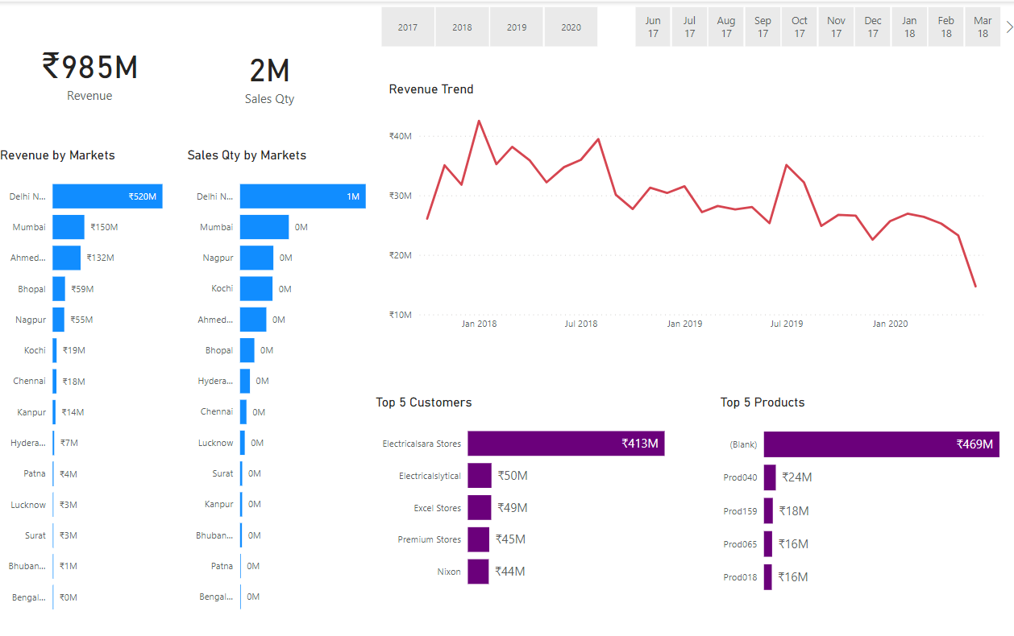
RESULT

Slide 10
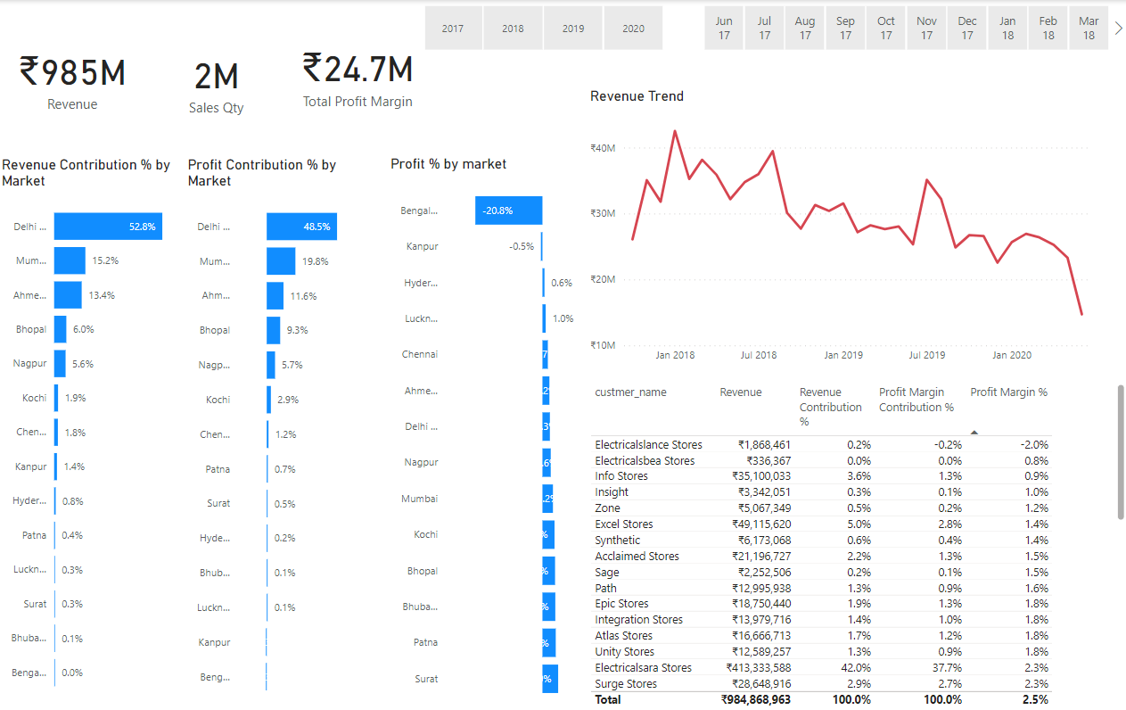
RESULT

Slide 11
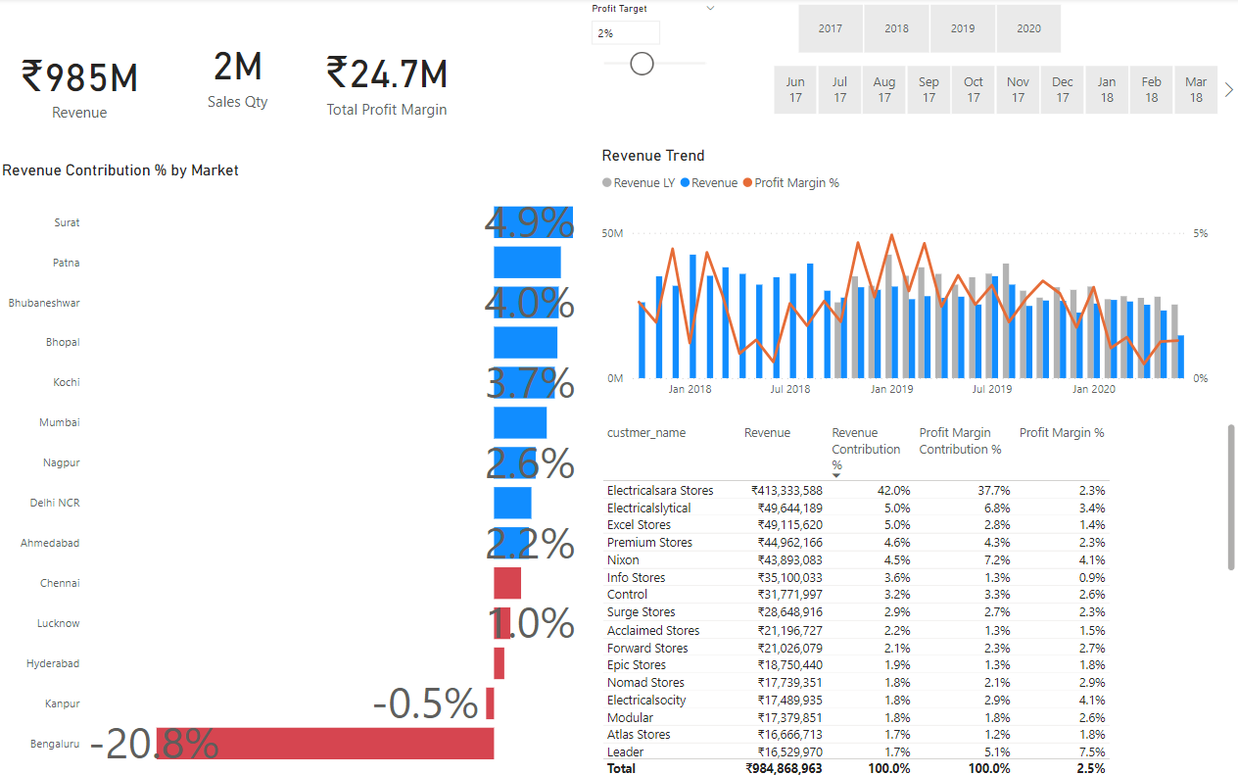
RESULT

Slide 12
Conclusion
In conclusion, this data analysis project has provided a comprehensive understanding of executing corporate-level projects aimed at generating sales insights.
Through the guidance of experienced professionals and a structured approach, participants have learned key concepts such as problem formulation, data discovery, cleaning, and visualization using Power BI.
The project's interactive nature, including stakeholder engagement and feedback integration, mirrors real-world scenarios, preparing participants for roles as data analysts or data scientists.
By leveraging data-driven decision-making processes, stakeholders can make informed choices to drive business growth and increase sales.
Overall, this project serves as a valuable learning experience, equipping participants with practical skills and expertise essential for success in the field of data analysis.

Slide 13
REFERENCE
1. Wang, Y., & Miao, Y. (2023). Design and Implementation of Sales Data Analysis System Based on Power BI. 2023 IEEE International Conference on Artificial Intelligence and Computer Applications (ICAICA), pp. 369373.
2. Patel, D., & Dave, K. (2019). Leveraging Power BI for Sales Performance Analysis: A Case Study. International Journal of Engineering and Advanced Technology (IJEAT), Vol. 9(2), pp. 40004007.
3. Chang, H., & Lin, C. (2019). Using Power BI for Analyzing Sales Performance and Customer Behavior: A Case Study in Retail Industry. 2019 IEEE International Conference on Engineering, Technology and Innovation (ICE/ITMC), pp. 16.

